Slide 1
Task 1
Identifying categories of hate memes

Slide 2
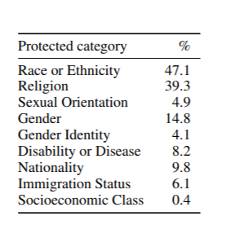
Hate speech categories
These are the 9 categories that can be
considered for hate meme classification

Slide 3
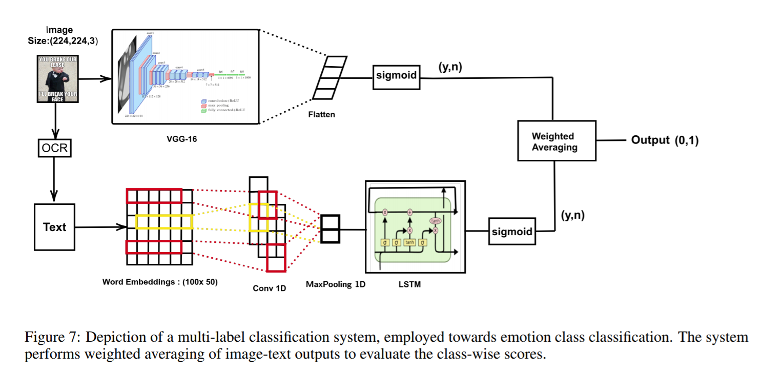
SEMEVAL-2020 TASK 8: MEMOTION ANALYSIS- THE VISUO-LINGUAL METAPHOR!
Task A- Sentiment Classification
Task B- Overall Emotion
Task C- Scales of Semantic Classes

Slide 4
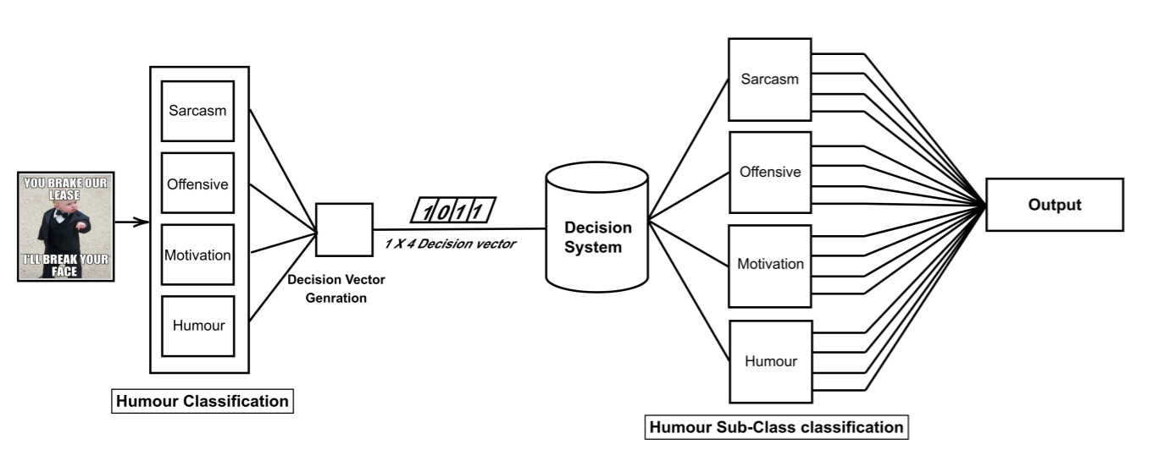
A Multi-level system for the task of emotion intensity prediction (1×14 dimensional), using the emotion class multi-label output (1×4 dimensional).

Slide 5
References
https://arxiv.org/pdf/2005.04790.pdf
https://arxiv.org/pdf/2008.03781.pdf

Slide 6
Task 2 : Reasoning Of Meme Labelled Into Different Categories

Slide 7
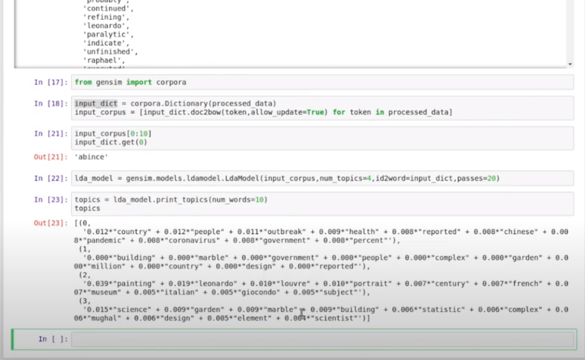

Slide 8
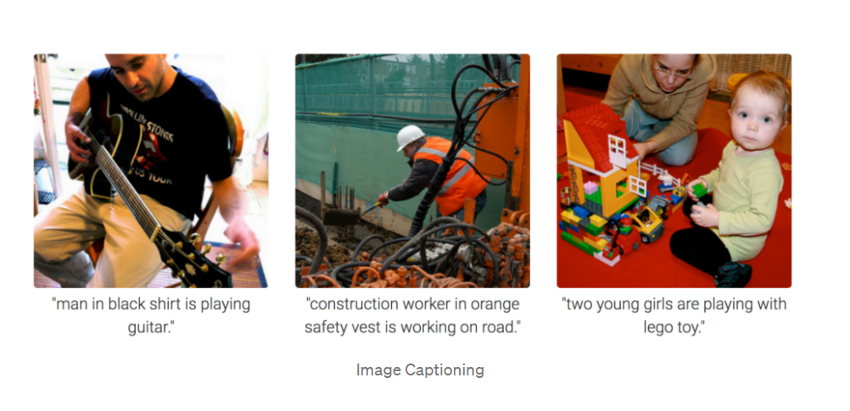

Slide 9
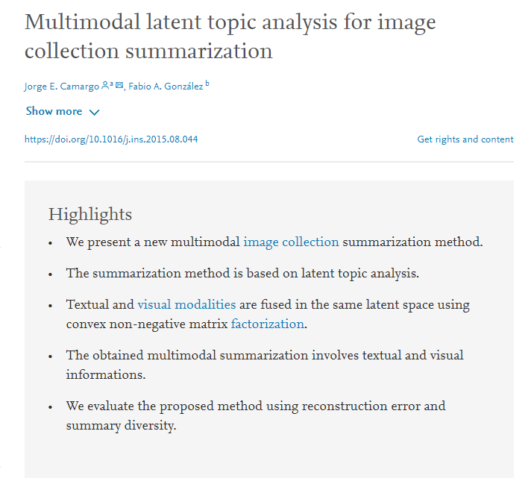
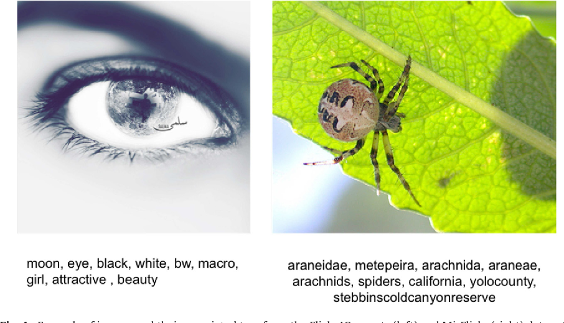
https://www.sciencedirect.com/science/article/pii/S0020025515006404

Slide 10
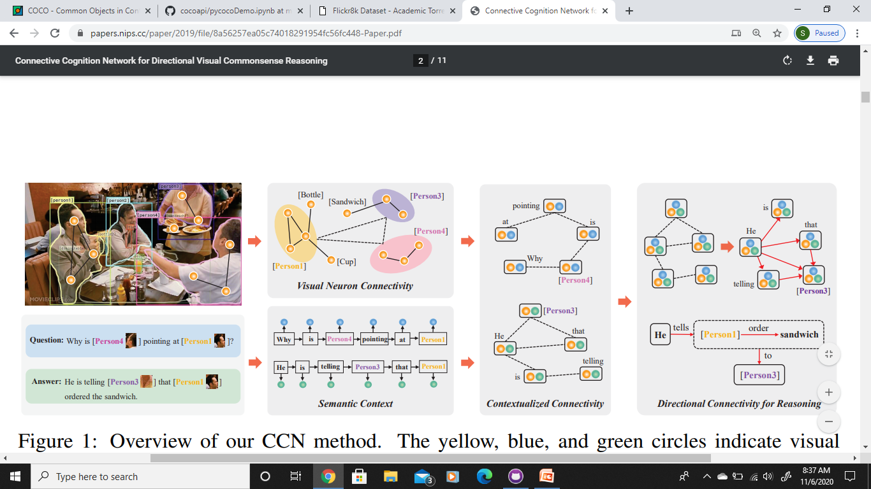
Connective Cognition Network for Directional Visual Commonsense Reasoning
https://papers.nips.cc/paper/2019/file/8a56257ea05c74018291954fc56fc448-Paper.pdf
Dataset : Visual Commonsense Reasoning
List of objects
A query
A set of N responses

Slide 11
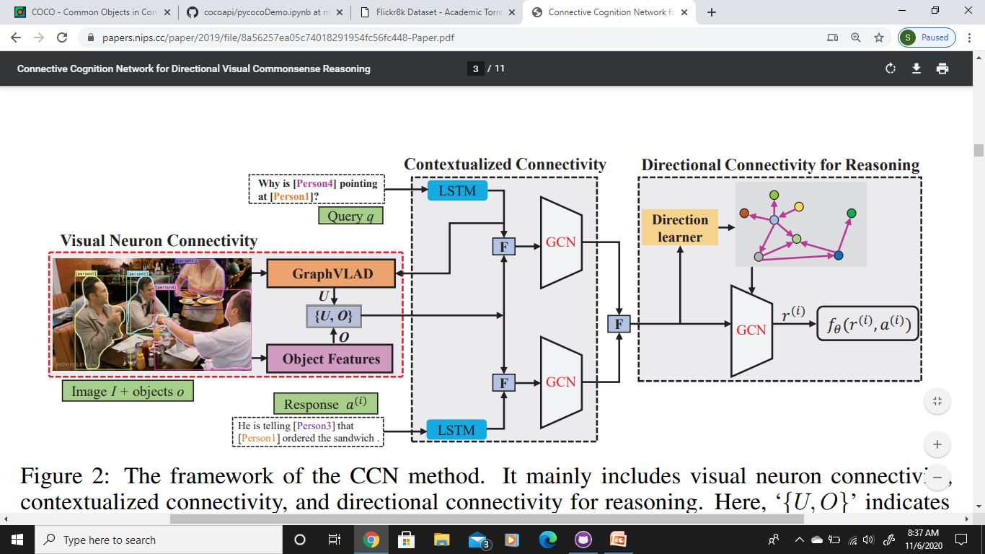

Slide 12
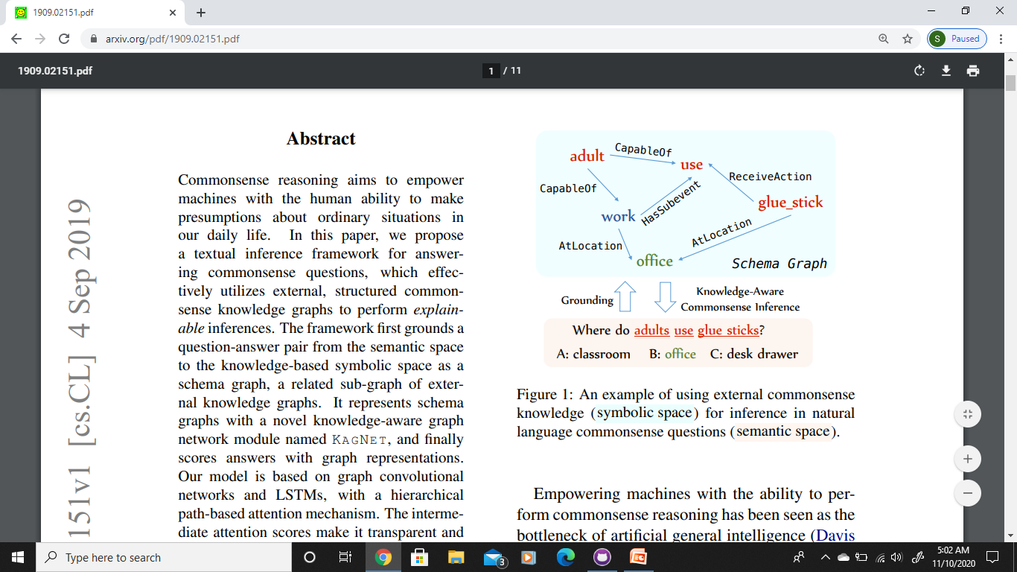
KagNet: Knowledge-Aware Graph Networks for Commonsense Reasoning
https://arxiv.org/abs/1909.02151

Slide 13
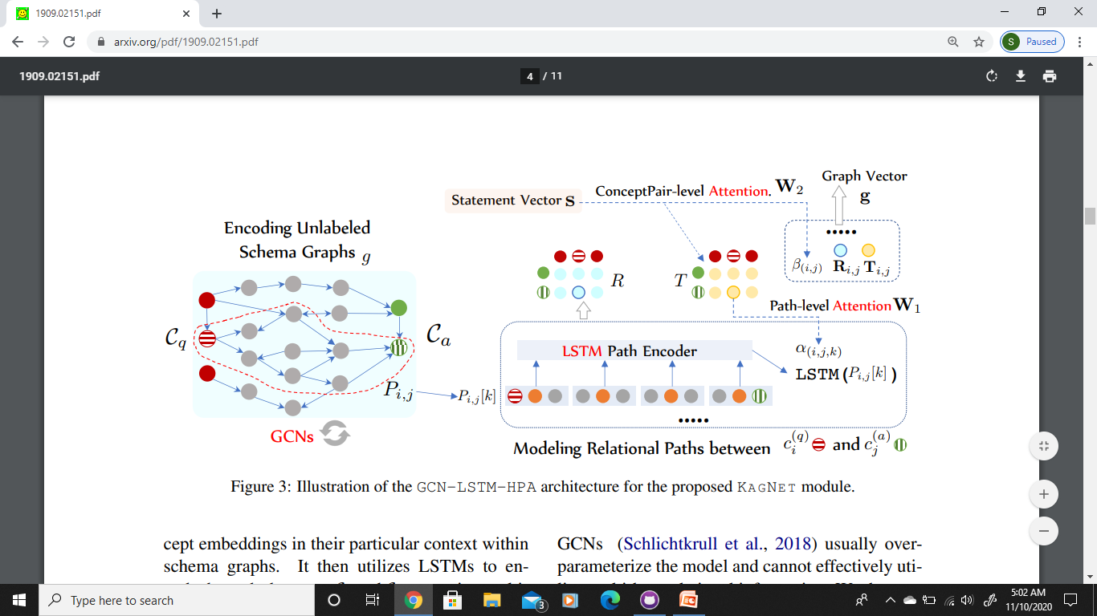

Slide 14
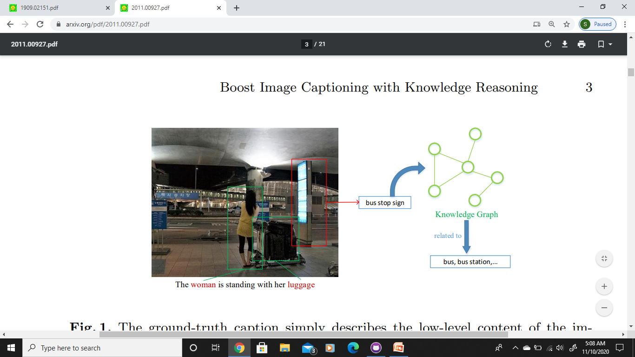
Boost Image Captioning with Knowledge Reasoning
https://arxiv.org/pdf/2011.00927.pdf

Slide 15
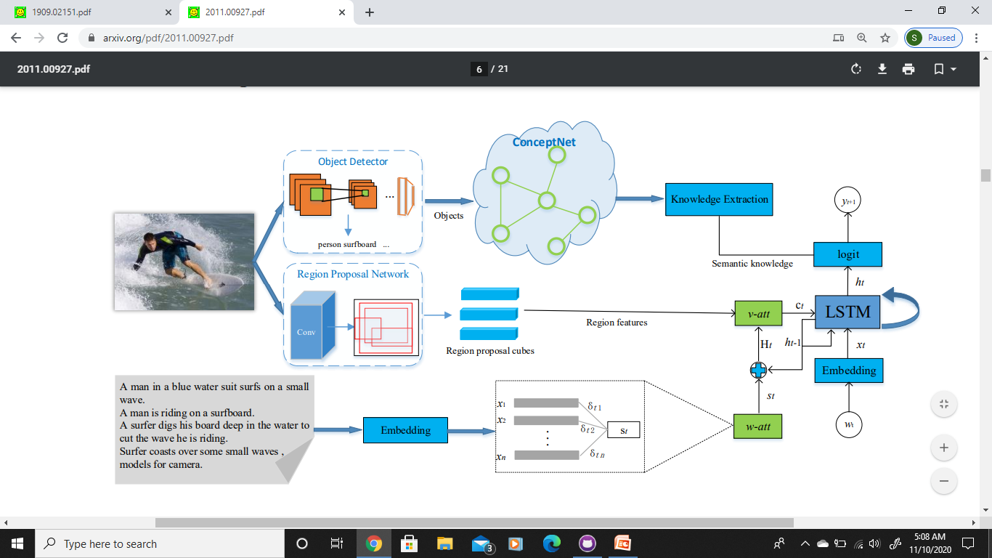

Slide 16
Proposed Methodology
IMAGE
CONTEXTUALIZED CONNECTIVITY
TEXT
REASONING
LANGUAGE GENERATION
REASON
LABEL

